Slide 1



Customer Churn Analysis
View in Power BI
Last data refresh:
8/3/2024 10:59:46 AM UTC
Downloaded at:
8/3/2024 11:02:39 AM UTC

Slide 2
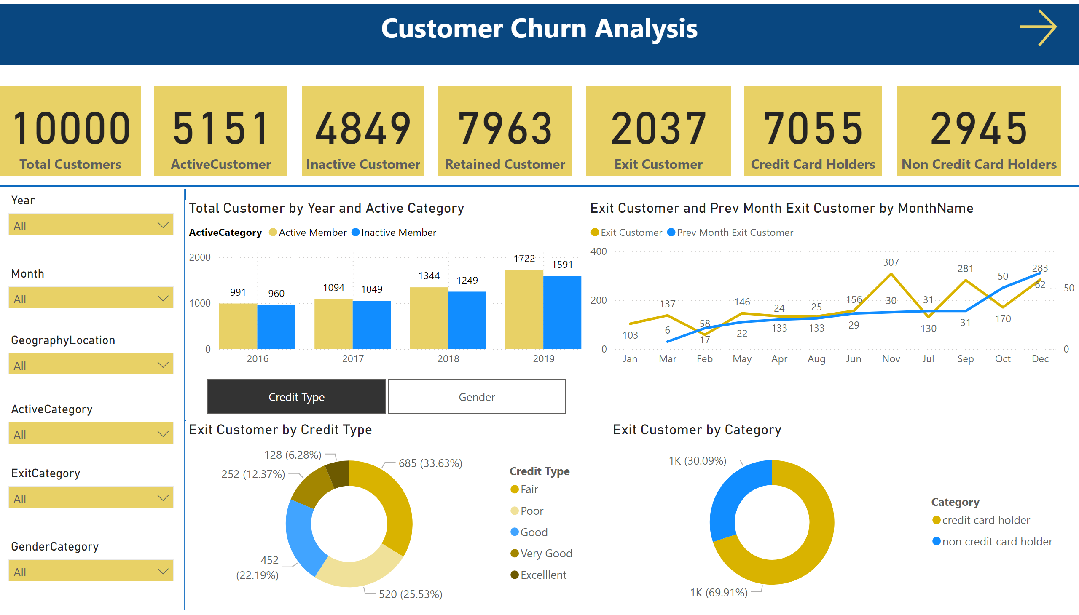
Notes:
card
No alt text provided
card
No alt text provided
card
No alt text provided
card
No alt text provided
card
No alt text provided
textbox
No alt text provided
card
No alt text provided
card
No alt text provided
textbox
No alt text provided
textbox
No alt text provided
shape
No alt text provided
slicer
No alt text provided
slicer
No alt text provided
slicer
No alt text provided
slicer
No alt text provided
slicer
No alt text provided
slicer
No alt text provided
shape
No alt text provided
Total Customer by Year and Active Category
No alt text provided
lineChart
No alt text provided
donutChart
No alt text provided
clusteredBarChart
No alt text provided
donutChart
No alt text provided
actionButton
No alt text provided
slicer
No alt text provided

Slide 3
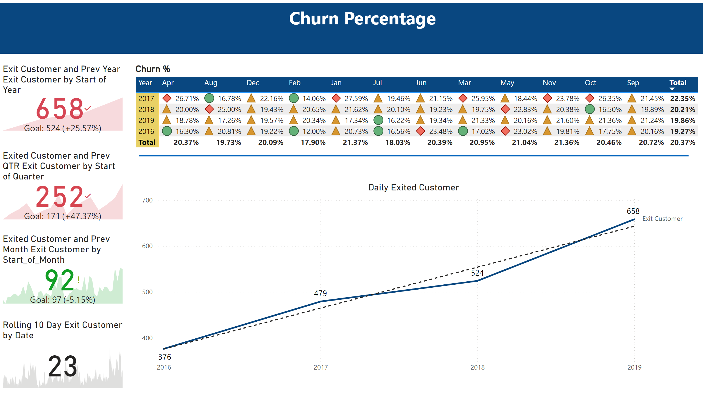
Notes:
Churn %
No alt text provided
kpi
No alt text provided
kpi
No alt text provided
kpi
No alt text provided
textbox
No alt text provided
kpi
No alt text provided
Daily Exited Customer
No alt text provided
shape
No alt text provided

Slide 4
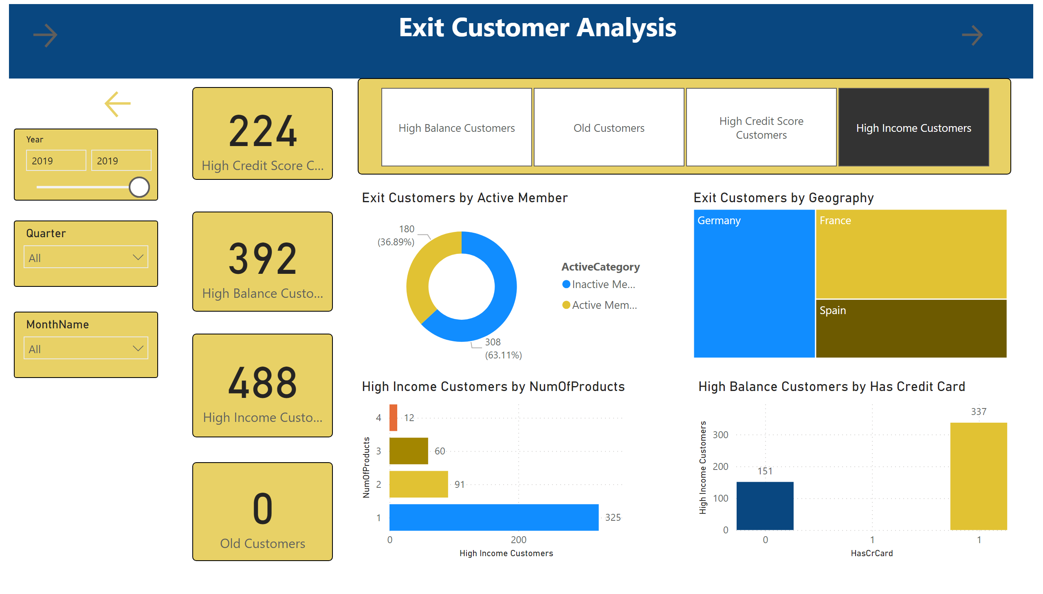
Notes:
textbox
No alt text provided
card
No alt text provided
card
No alt text provided
card
No alt text provided
card
No alt text provided
Exit Customers by Active Member
No alt text provided
slicer
No alt text provided
slicer
No alt text provided
slicer
No alt text provided
Exit Customers by Geography
No alt text provided
textbox
No alt text provided
actionButton
No alt text provided
actionButton
No alt text provided
actionButton
No alt text provided
slicer
No alt text provided
barChart
No alt text provided
High Balance Customers by Has Credit Card
No alt text provided

